Slide 1







Puppy master
DATA SCIENCE II / TU DARMSTADT
DeadLock

Slide 2
Contents
1 Overview
4 UI Design & Project structure
2 Data collection and augmentation
5 Demo
3 Model
6 Q&A

Slide 3


Team STRUCTURE
Johannes Wowra
Supervisor
DATA COLLECTION
MODEL TRAINGING
UI IMPLEMENTATION
DATA AUGMENTATION
MODEL EVALUATION
PROJECT IMPLEMENTATION
Jian Jiang
Haoyue Zhu
Keren Zhou
Ruize Xia
Xiaoyan Xue

Slide 4

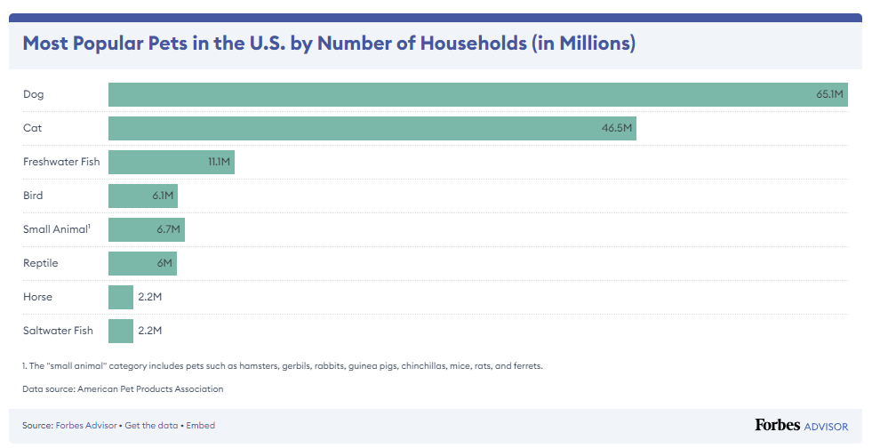
Project overview
DOGS: MOST POPULAR PETS
Dogs are the most popular pet in the U.S. (65.1 million U.S. households own a dog)
Essential dog expenses cost an average of $1,533 annually.
42% of dog owners got their pets from a store, while 38% of dog owners got their pets from an animal shelter or rescue.

Slide 5

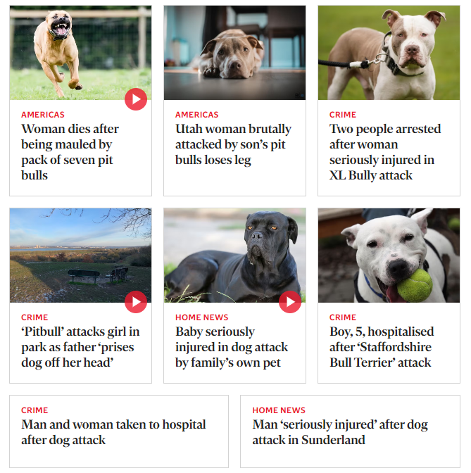
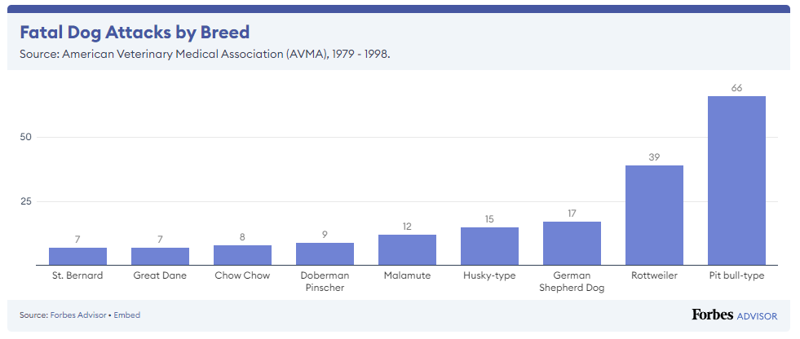
Project overview
DOGS BITING: POTENTIAL RISK AROUND YOU
Every year, an estimated 4.5 million people are bitten by dogs in the United States.
15.55% of dog bites were committed by stray dogs rather than pets.

Slide 6
Project overview
What?
A system that offers a quick and simple classification tool for breeds of the dogs.
Why?
Get the breed information as soon as possible to prevent from the dog attack accidents.
Whom?
Dog owners that not sure the breeds of their dogs.
Anyone who finds a dog nearby and worries about the potential risk of biting.

Slide 7
DATA COLLECTION & Augmentation
Haoyue Zhu
Jian Jiang

Slide 8
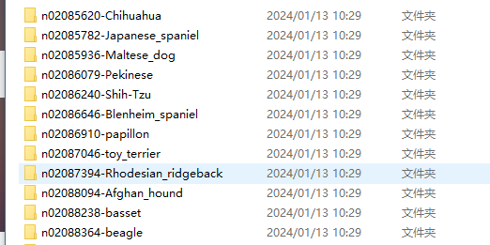
Data collection
Original Dataset: Stanford Dogs Dataset
Images of 120 breeds of dogs from around the world.
Number of categories: 120
~150 images per class
Total images: 20,580
Annotations: Class labels, Bounding boxes

Slide 9
Data Augmentation
· Why?
Data augmentation can improve the generalization and robustness of the deep learning model.
· How?
We can apply various transformations to the existing images.
Rotation, Flip, Contrast Adjustment, Color Jittering, Gaussian Noise, Sharpen...

Slide 10
Data Augmentation
· Problem we have:
The dataset contains more than 20,000 images.
Processing the images one by one is impossible.
· How can we solve it?
We choose to use Image Batch Processor in MATLAB,
which can use the functions to process thousands
of images simultaneously.

Slide 11
Data Augmentation
Functions decided to use:
· Gray
· Reduce the Contrast
· Flip
· Mirror
· Gaussian Noise
· Sharpen
Augmented dataset:
20K*6 = 120K images for training!

Slide 12
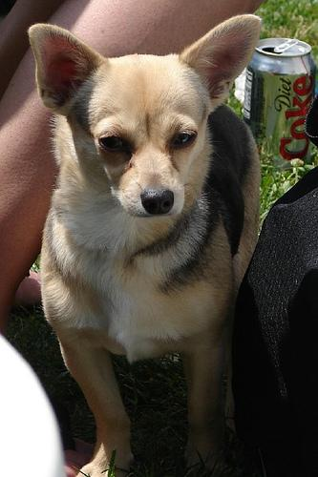
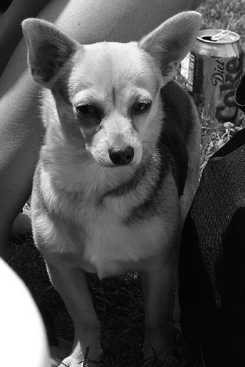
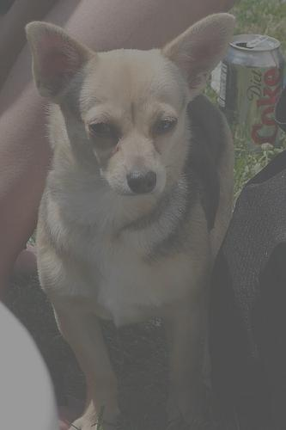
Data Augmentation
Original
Gray
Reduce the Contrast
Stanford Dogs Dataset
http://vision.stanford.edu/aditya86/ImageNetDogs/

Slide 13
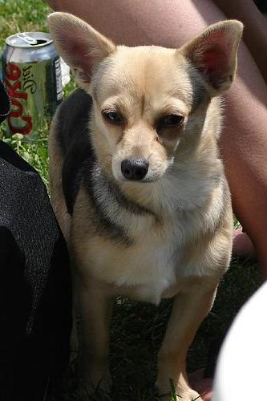
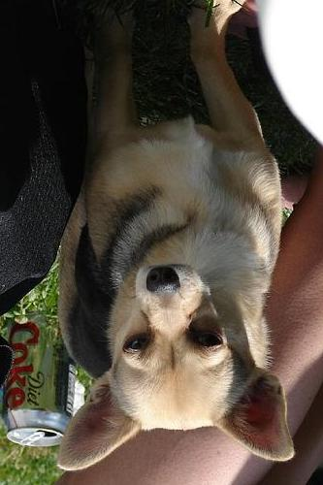
Data Augmentation
Original
Mirror
Flip
Stanford Dogs Dataset
http://vision.stanford.edu/aditya86/ImageNetDogs/

Slide 14
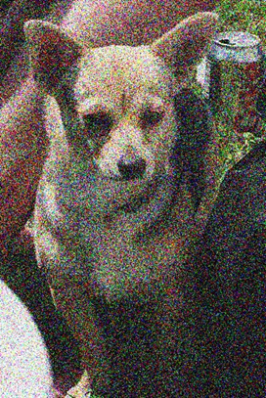

Data Augmentation
Original
Gaussian Noise
Sharpen
Stanford Dogs Dataset
http://vision.stanford.edu/aditya86/ImageNetDogs/

Slide 15
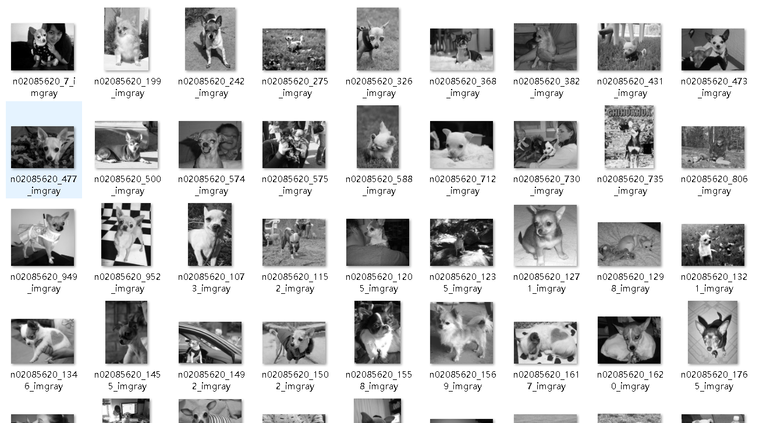
Data Augmentation
Example:
Gray function
· 20,000 images for more than 1 hour
· Takes a lot of time
But acceptable!

Slide 16
Model training & evaluation
Keren Zhou
Ruize Xia

Slide 17
OUTLINE
1 What is resnet
6 Visualizing The Metrics Curves
2 Why Resnet50
7 Prediction
3 Work Flow
4 Building a Model
5 TRAINING

Slide 18
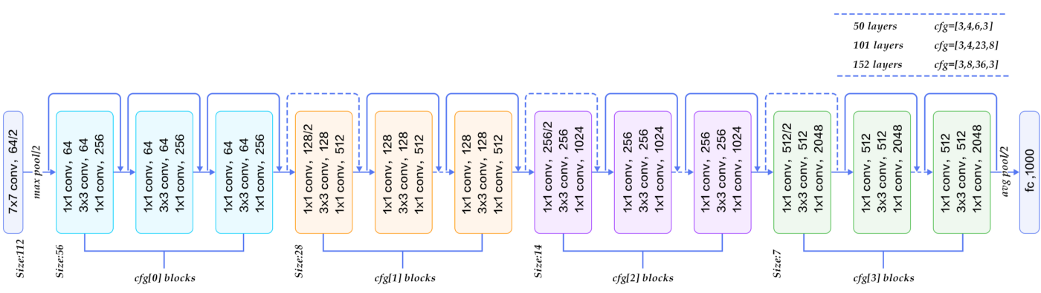
What is resnet
Short for Residual Networks, is a classical convolutional CNN architecture for deep learning.
Composed of residual blocks. Each block contains a shortcut connection that skips one or more layers.

Slide 19
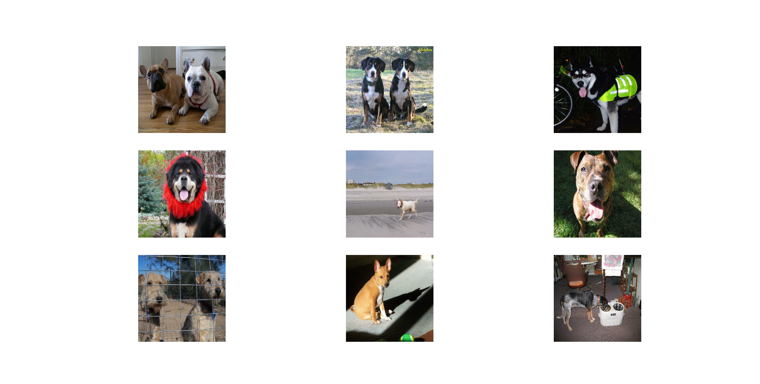
Why Resnet50
Addressing Gradient Issues
Deeper Networks
Alleviating Degradation Issues
Efficient Model Training
Transfer Learning

Slide 20
Work flow
Building a Model
Visualizing The Metrics Curves
Fetching Data
Training
Prediction

Slide 21
Building a Model
Rescaling Layer
Pre-trained Model
Dropout Layer
Dense Layer
Adam Optimizer
Loss

Slide 22
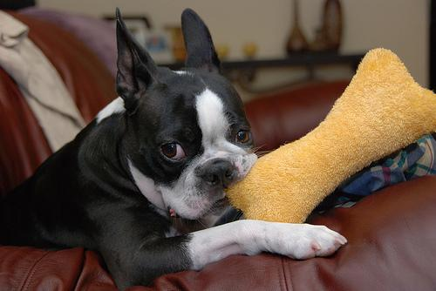
TRAINING
We will add 3 Very Important Callbacks for our model
ModelCheckpoint: This callback saves the model weights after every epoch if the validation loss improves.
EarlyStopping: This callback stops the training process if the validation loss doesn't improve for a certain number of epochs.
ReduceLROnPlateu: This callback monitors a quantity and if no improvement is seen for a 'patience' number of epochs, the learning rate is reduced.

Slide 23
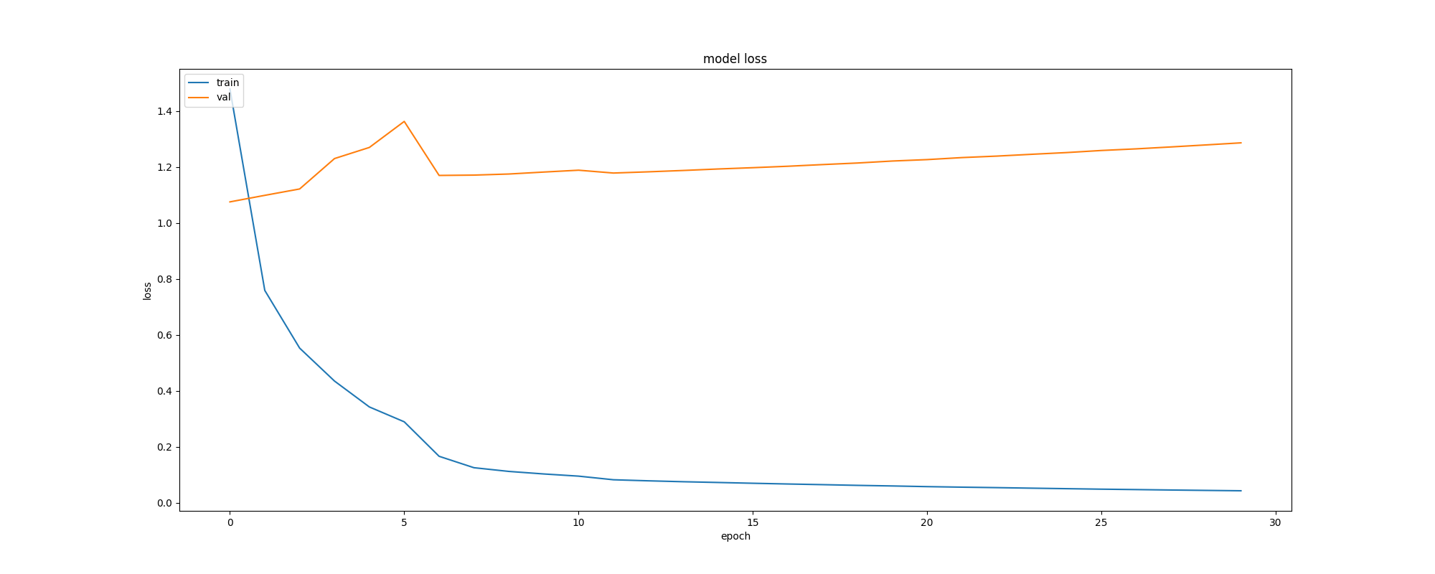
Visualizing The Metrics Curves
After the cross-validation, we can see……

Slide 24
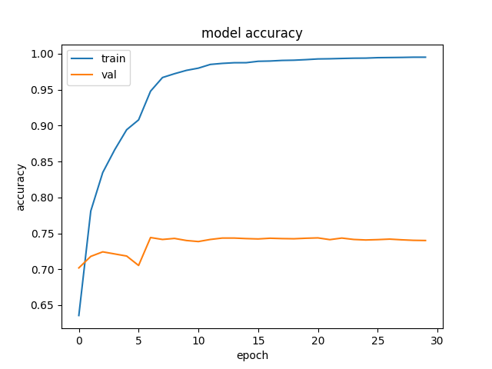
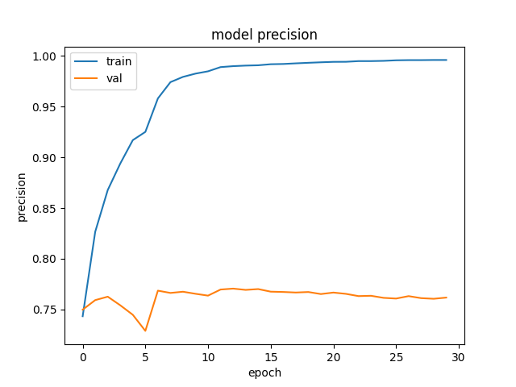
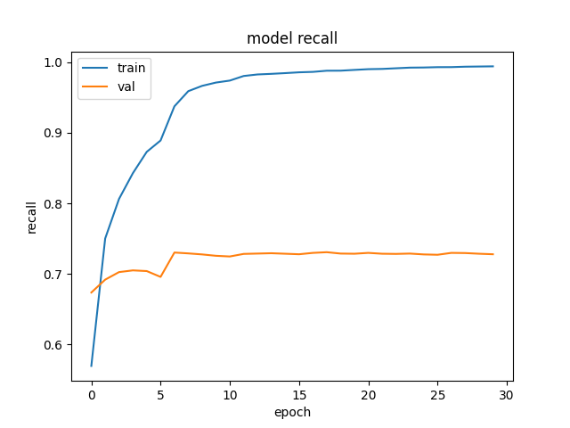

Visualizing The Metrics Curves

Slide 25
Visualizing The Metrics Curves
After the cross-validation, we can see……
Epochs: 30
Multi-class balanced accuracy: 0.732 (train) / 0.734 (validation)
Epochs: 30
Loss function:6.303 (train) / 7.083 (validation)

Slide 26
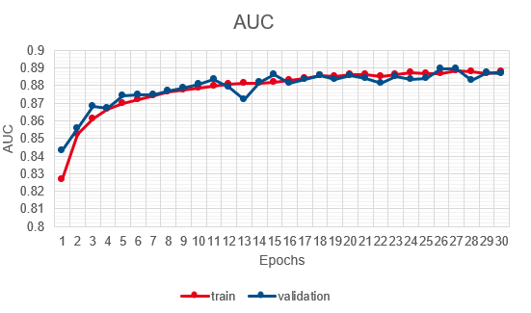
Visualizing The Metrics Curves
Epochs: 30
Precision: 0.732 (train) / 0.735 (validation)
Epochs: 30
AUC(Area under curve):0.888 (train) / 0.887 (validation)

Slide 27
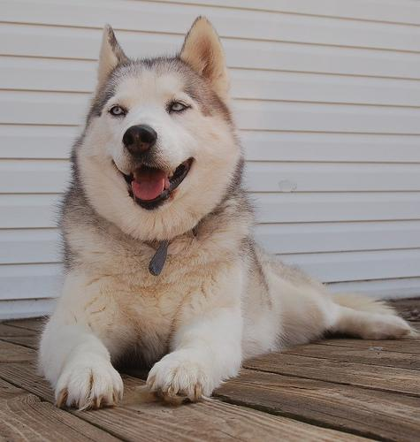
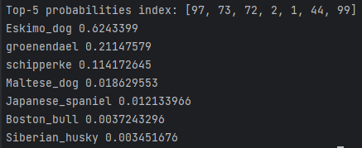
Prediction

Slide 28
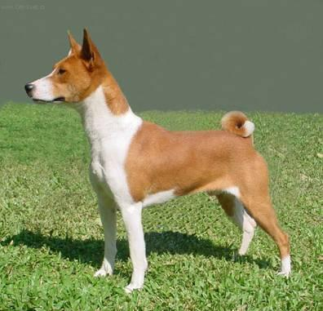
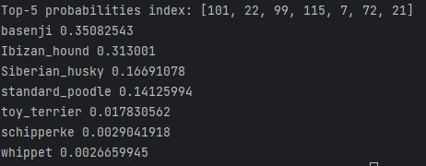
Prediction

Slide 29
User interface & project implementation
Xiaoyan Xue

Slide 30
Project structure
Tech stacks
DATABASE
BACK-END
FRONT-END
HTML5
CSS3
MYSQL
JAVA
Swagger
Redis
JavaScript
Breed
SpringBoot
MyBatis
React
Record
Node
Prediction
Python
Umi
Tensorflow
Numpy
User
Ant Design
Matplotlib
Scikit-learn

Slide 31
Project structure
Data flow
DATABASE
BACK-END
FRONT-END
HTML5
CSS3
MYSQL
JAVA
2. MYSQL Query
Swagger
Redis
JavaScript
Breed
1. HTML Request
SpringBoot
MyBatis
React
Record
5. Predicted
Breed Information
6. Display
Information
Node
Prediction
Python
3. Invoke Python
Classifier
Umi
Tensorflow
Numpy
User
Ant Design
Matplotlib
Scikit-learn
4. Predicted
Breed Class
06.02.2024
31

Slide 32
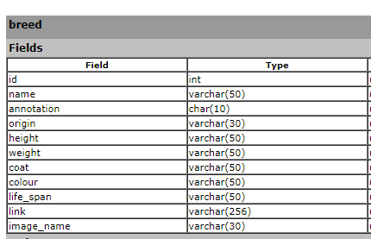
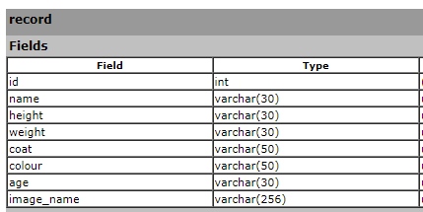
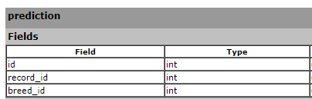
Project structure
database
Breed Information
Record Information
Prediction Information

Slide 33
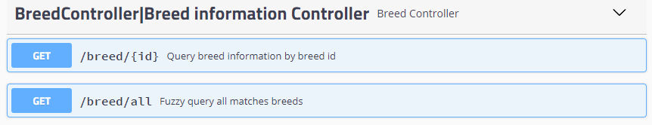
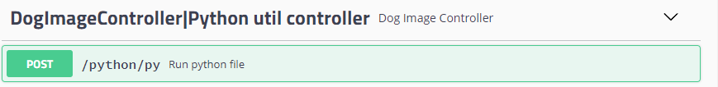
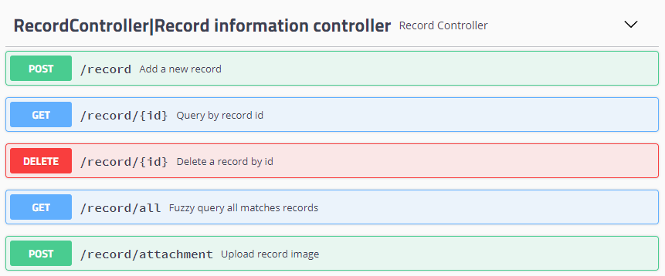
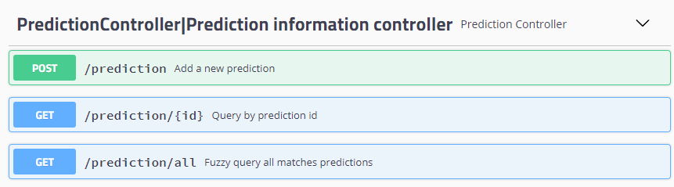
Project structure
BACKEND

Slide 34
UI display
frontEND
Demo display!

Slide 35
Related work

Slide 36
RELATED WORK
Data
Dataset: More high quality dataset for model training
Augmentation: Clip object position to have better annotations
Model
Training: More variety of model such as resnet-152
UI
More user-friendly functionalities: archives, alarms, etc.
More platforms supported
Training: More Epochs, different hypermeters research such as MC dropout

Slide 37
Thanks for watching!
Any questions?
DATA SCIENCE II / TU DARMSTADT
DeadLock

